Slide 1
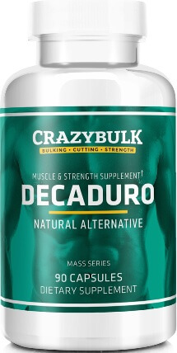
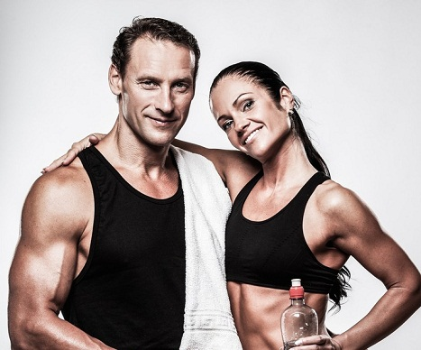
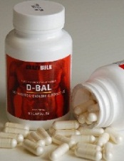
Legal Steroids
Are you looking for the safest and best steroids to help you bulk up muscle fast, increase mass size or reduce bodyfat and gain sexy lean physique you can show off? This expert report may answer your prayers…

Slide 2
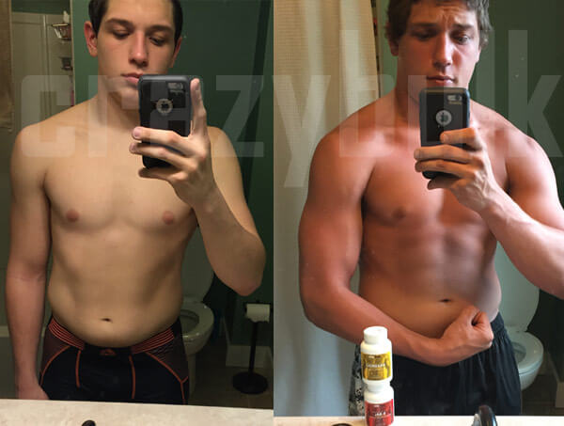
Best Steroids
An average muscle builder and fitness conscious person really work extra hard and have the right dietary intake, coupled with high sense of motivation and discipline.
Basically the aim and ultimate desire is to either bulking up, getting bigger and stronger faster. Some desire to shred body fat and retain the lean muscle mass to improve their health

Slide 3
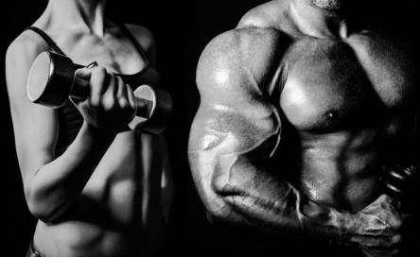
Best Legal Steroids
A Simple Trick To Help You Discover Best Legal Steroids to Help You Achieve Your Goals
If you are looking where to buy steroids, it’s important to know what you’re getting into.
Do you want to gain mass?
Are you skinny or average size and desire to build BIG muscle fast?
Are you looking for help to lose body weight or build lean muscle or both – safely and effective?
Do you need more and strength energy for workouts?

Slide 4
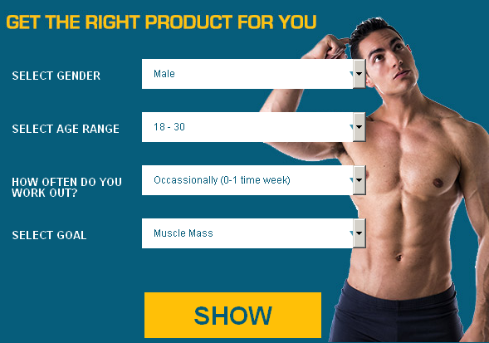
Best Steroid Stack
We’ll be glad to hear from you and help. Please use the form below to contact us immediately. We respond within 24-48 hours.

Slide 5


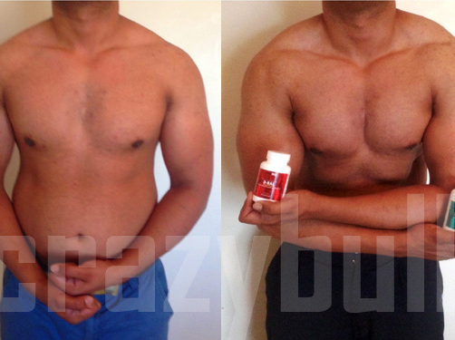



Legal Steroids
legalsteroidsmuscle.com

