Slide 1
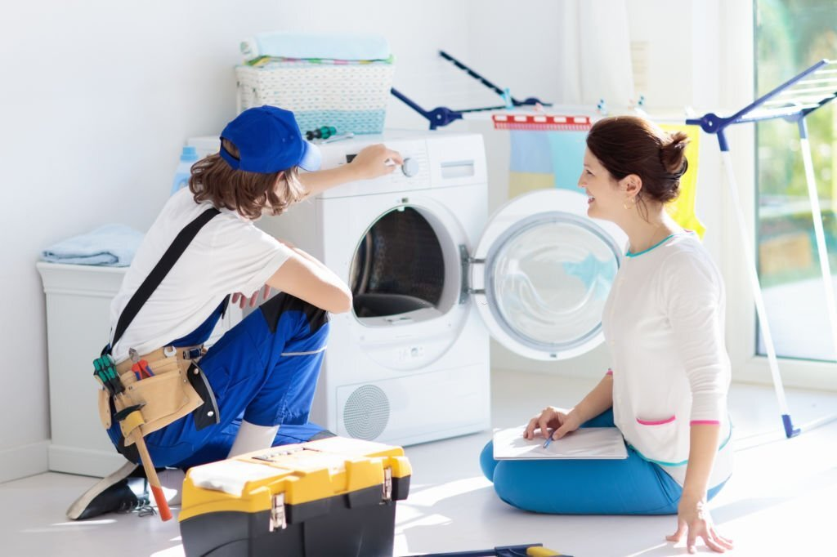
Engage Professionals for Tumble Dryer Repair in Harrow

Slide 2
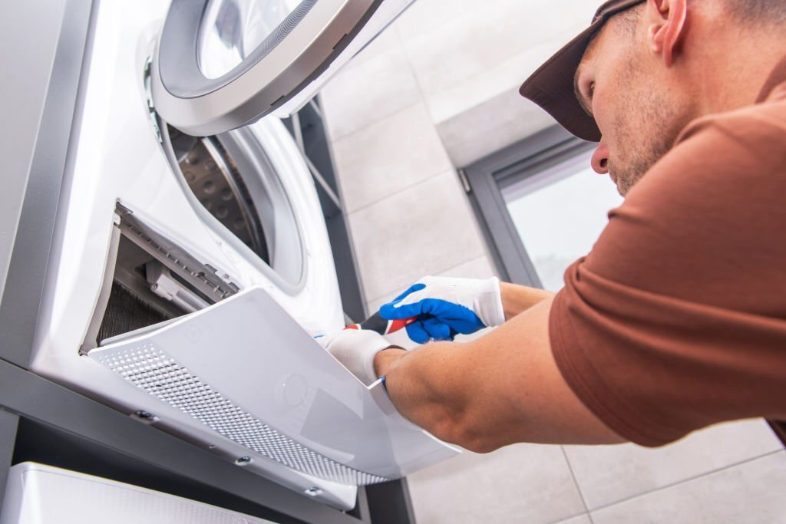
One of the most common causes of appliance breakdowns is overloading. Many people tend to put more clothes in their machines than they can handle. The result? Your clothes come out damp and wrinkled.

Slide 3
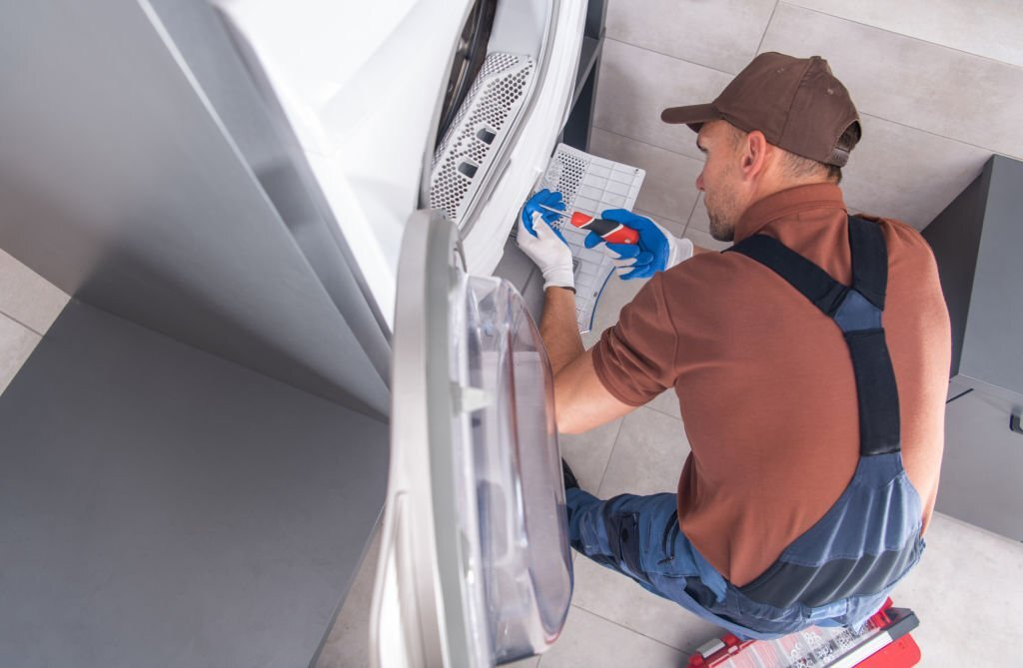
You should invest in a tumble dryer repair service to save your clothes from damage. Repairing your tumble dryer by getting assistance for tumble dryer repair in Harrow is an excellent idea to prevent it from breaking down in the future.

Slide 4
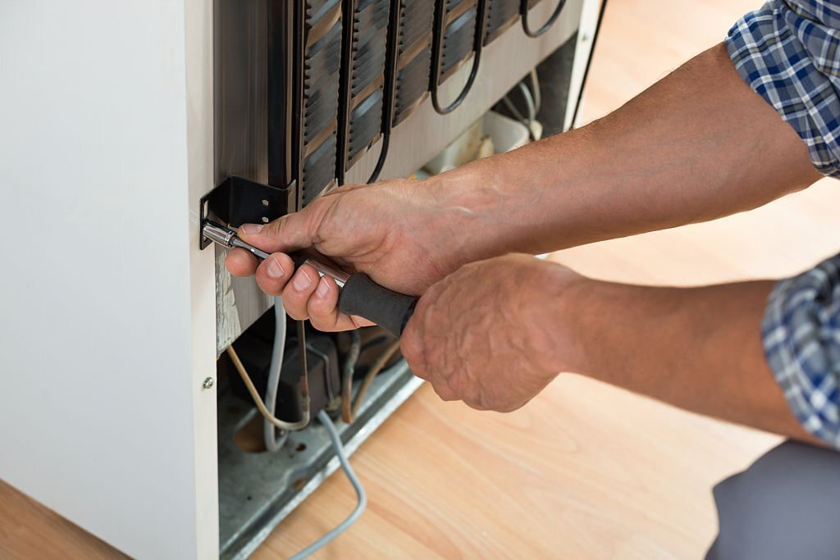
A technician will check your machine for damages and ensure everything works correctly. You might be looking to engage professionals for fridge freezer repair. The benefits of engaging experts for fridge freezer repair in Harrow are manifold. They include:
The appliance will last longer

Slide 5
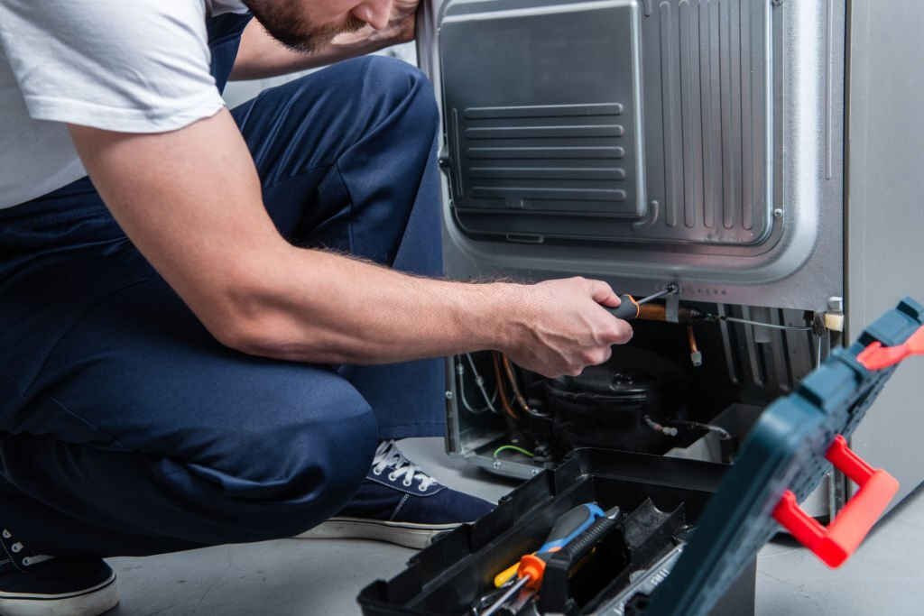
If you have a broken refrigerator or freezer, you can fix it in a matter of hours with the help of professional appliance technicians.
The cost will be lower
When you don't need to buy a new one, your repair costs are cheaper than buying a new one.
The convenience factor
When you have an appliance repaired, you can use it again without any hassle or inconvenience.

Slide 6
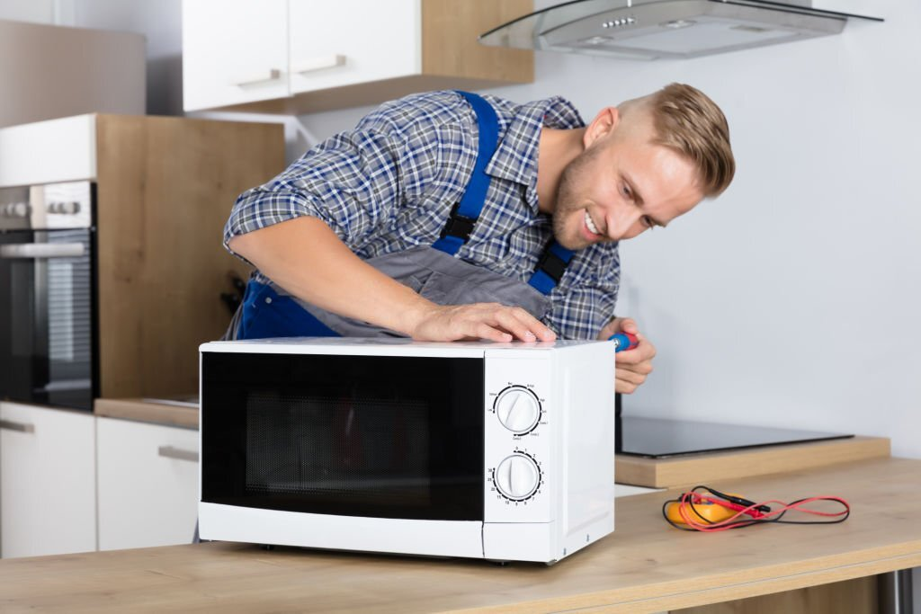
Engaging experts for microwave repair in Watford is becoming an increasingly popular trend. Microwaves often get broken or stop working for various reasons like power outages, overheating, etc. Microwave ovens are prevalent in today's kitchens, providing a fast and easy way to cook food.

Slide 7
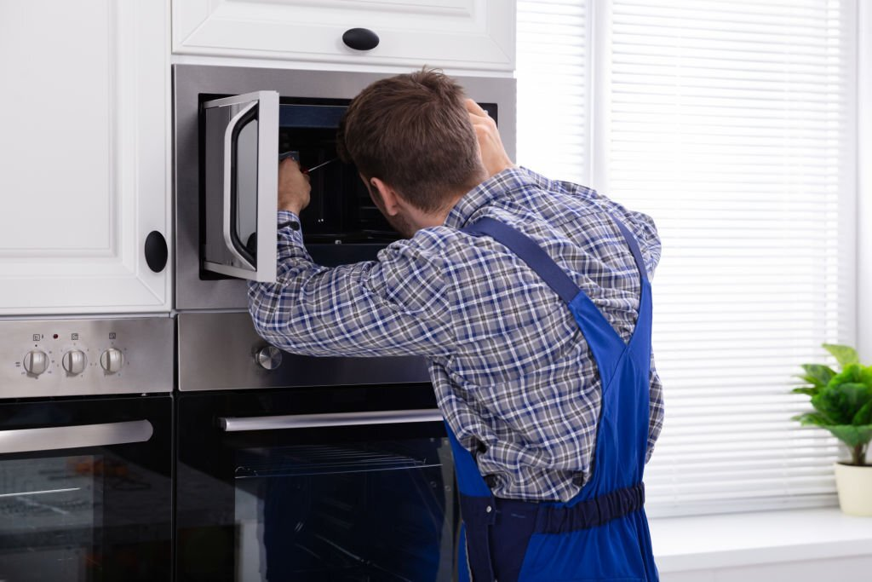
However, like all appliances, they are subject to wear and tear and may eventually need to be repaired. While it is possible to fix a microwave oven yourself, the general recommendation is that you leave this task to a qualified professional. It is because microwave ovens contain electrical components that can be dangerous if mismanaged.

Slide 8
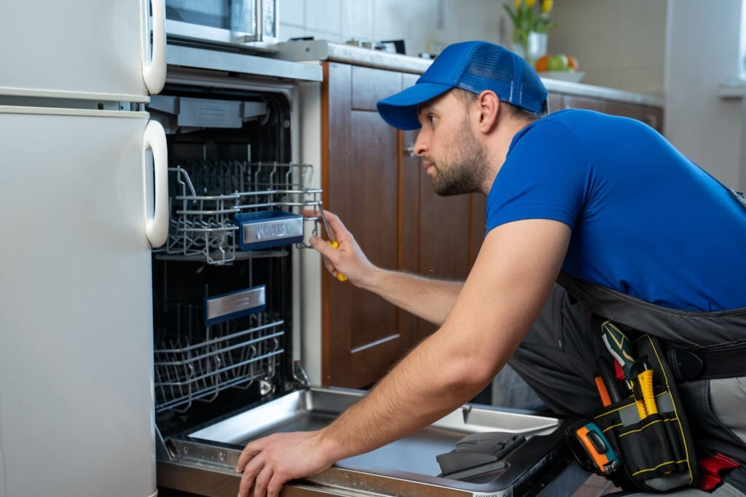
Why is dishwasher repair a necessity?
You must be familiar with the phenomenon of hiring professionals for dishwasher repair in Harrow. Many think dishwashers are a necessary and essential appliance in their kitchens. While this may be true for some, dishwashers may also be costly.

Slide 9
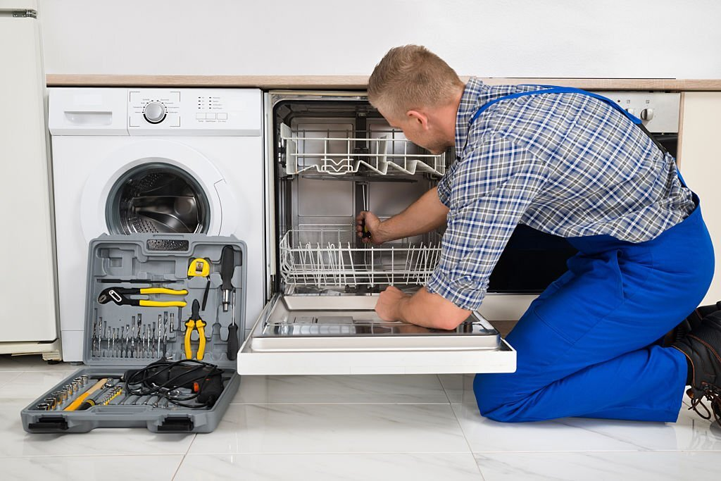
Over time, dishwashers can start to experience problems that can affect their function. It can lead to frustration and inconvenience for the person using the dishwasher.

Slide 10
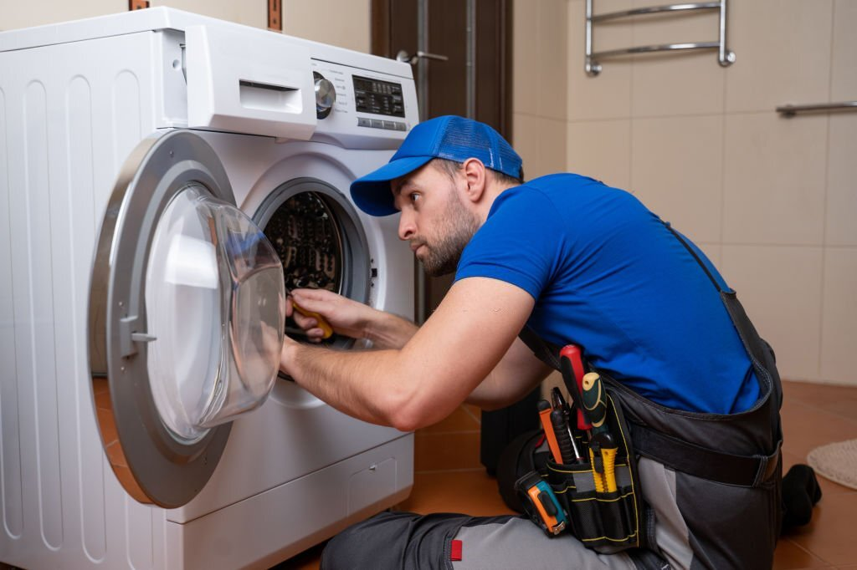
Why washing machine repair and servicing is a crucial phenomenon?
Washing machine repair in Hemel Hempstead is a complex task that needs expert assistance. If you notice strange noises from your washing machine, it might be time to take it in for servicing. Sometimes, there are simple solutions that you can do at home.

Slide 11
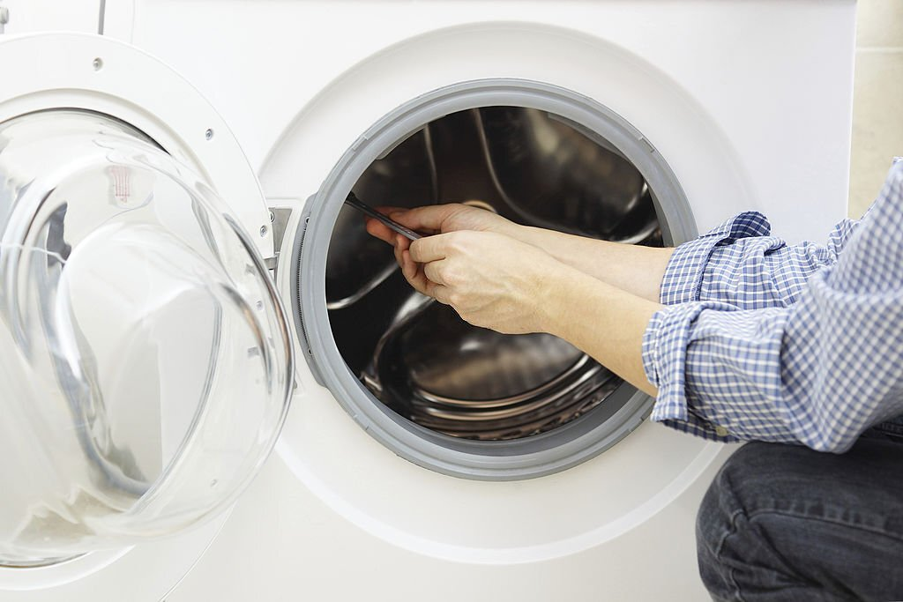
For example, if you notice water spilling out of your machine when it is filling up, you might need to replace the washer hose.

Slide 12
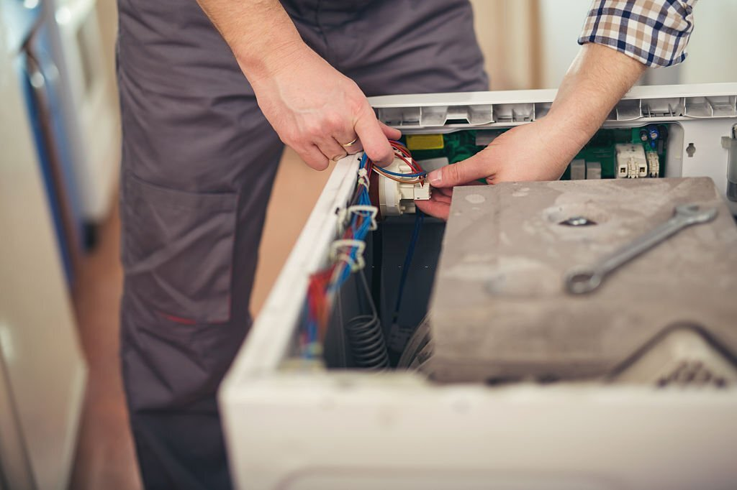
However, if you notice that your machine takes a long time to fill with water or if the water coming out of the device is pink or cloudy, you may have a problem. Reach out to a London Appliance professional to diagnose the issue.

Slide 13


