Slide 1
Creating a Culture of Value through HR
Isabella Serg
@isabella_serg

Slide 2
Value is in the mind and experience of each customer

Slide 3
HR’s role in the Agile Transformation
Started as an initiative to scale Agile across the Business Technology function
Highlighted the changing role of HR in creating an agile organization. HR’s role is not just to implement controls and standards but rather, to drive programs that create adaptability, innovation, collaboration and speed
To help our clients transform themselves we needed to transform ourselves too!

Slide 4
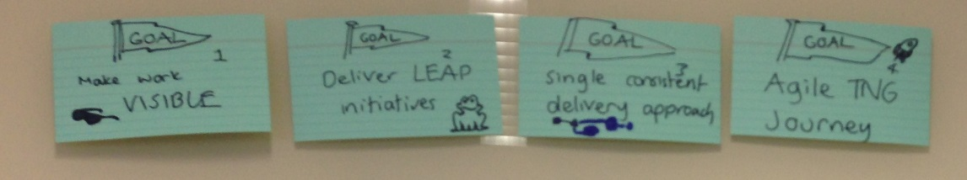
Drivers
Transparency and communication of planning and road blocks
Improve throughput measured via faster cycle time (10% improvement)
Increased response rate to high priorities
Understanding of Agile mindset, values, principles and practices

Slide 5
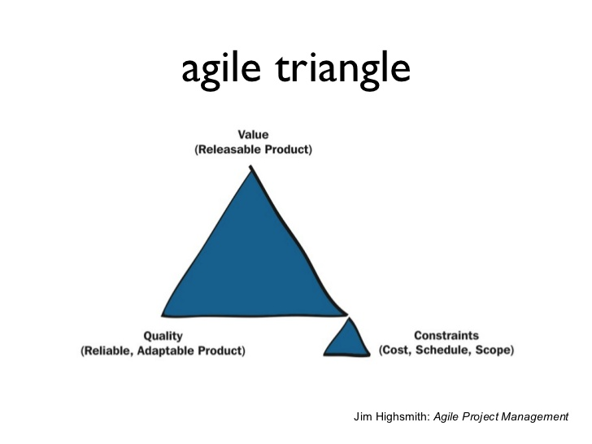
Focus on value
If our business objectives are to be responsive and agile then we need to reconsider how we measure success
Source: Jim HighSmith, Agile Project Management: Creating Innovative Products (2nd Edition), 2009

Slide 6
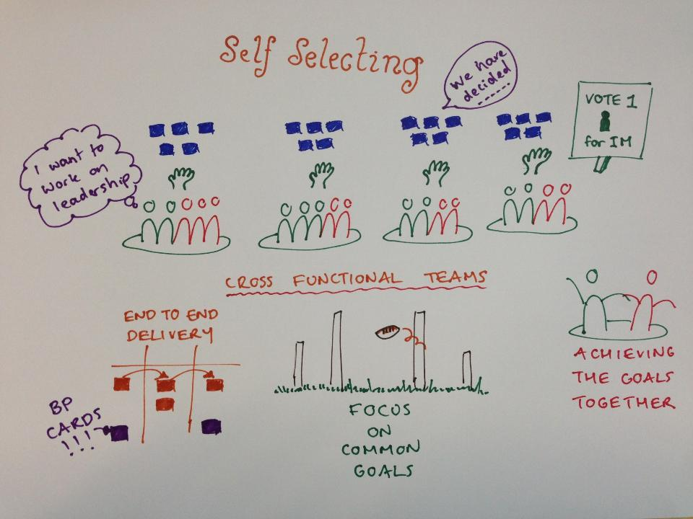
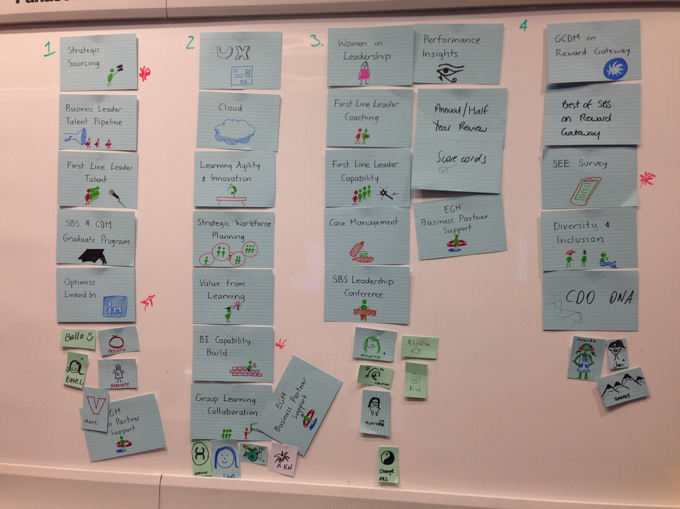
Self-selecting to form stable teams

Slide 7
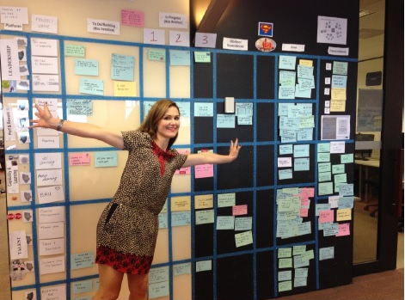
Leveraging prior exposure to accelerate Agile adoption
Some teams were already using Kanban – the focus was to keep the good things!
Kanban teams were the first to role model the use of other visual management tools e.g. JIRA, decision register and planning documentation

Slide 8
Observations
Because of the nature of HR business partnering and organisational design, teams struggled to pull ‘the next story card’ of highest value
HR teams felt stakeholders expected them to “JFDI”
Speed-to-value got (much) slower before it got faster
Trust is critical to creating a safe to fail environment; you need to do more than just say “this environment is safe to fail”

Slide 9
Results
Teams took ownership of their Agile journey by personalizing Agile to fit them
Improved speed-to-value for high priority work
Improved response time to ‘Business-As-Usual’ work
Reduction of overhead planning and improved visibility of pipeline
Minimized situations where one team member could potentially be overloaded

Slide 10
Creating a Culture of Value using Human Resources
Align agile transformation efforts to people strategy
Build a focus on continuous learning and learning culture at all levels
Create a mechanism for regular and robust performance feedback
Facilitate a decentralized, empowered and collaborative workforce
Prioritize speed-to-value over time and cost
Train your leaders to be coaches, not managers
Develop a passion for quality

Slide 11
Agile Is More Than a Process
When a business is agile, it can create and respond to change faster than the rate of change
Agile projects and adaptive leadership alter mental models and fuel the changes required to build learning organizations
It’s not enough to Do Agile processes and practices, a business must Be Agile by embracing the values, principles, and behaviors

Slide 12
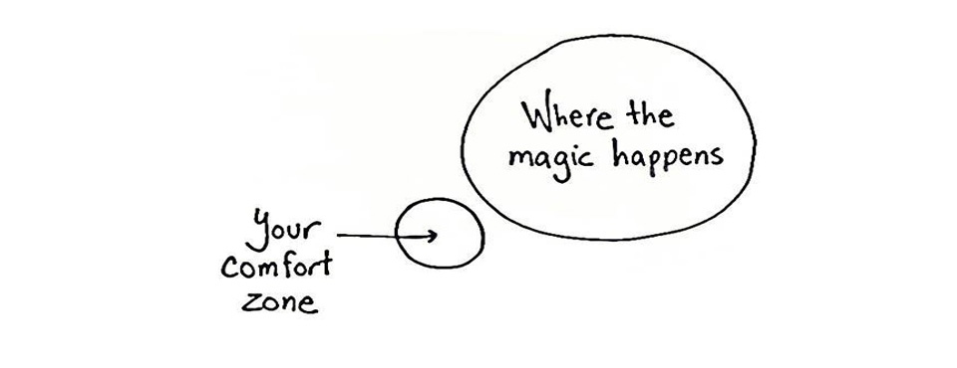
Note to self: Find Disruption

Slide 13
Isabella Serg
@isabella_serg

