Slide 1

The popular promotions offered by Delicious Slots Site
Delicious Slots has scooped the online casino charts for yet another year in a row. With it’s incredible offerings, the site has maintained it’s top positions at various popular online casino portals and continues to be the most popular online casino site. One of the stunning features of the site is it’s Promotions. The site has a very rewarding range of promotions to give players a sheer amount of joy in participating them. Let’s take a quick look at some of the popular promotions offered by the site that have made it on top for yet another year in a row.

Slide 2

£1,250 FLUFFY FRIDAY TOURNAMENT
This is not a drill – our Fluffy Fridays promotion is back this March! Giving you the chance to win a share of £250 in Real Cash prizes every Friday in March!
To join the fun, simply play your favourite Fluffy games between 7PM – 10PM every Friday in March to climb the in-game leaderboard by collecting points based on your wins: the bigger the win, the more points you’ll get.
Plus, remember that there will be a £250 Fluffy Friday Tournament running every Friday this month, which means you can win a share of £1,250 by playing Fluffy Favourites, Fluffy Too, Fluffy Fairground and Fluffy in Space.
Celebrate Friday in style!

Slide 3

SHAM-ROCKING GIVEAWAY
What time is it? It’s time you take part in this month’s Giveaway! Enter our Sham–rocking Giveaway today to win His & Hers TAG Heuer watches worth £2,000!
To be in with the chance of winning both TAG Heuer watches above simply wager a tenner or more on a selection of games between the 1st – 31st March.
Plus, every extra £10 wagered on Rainbow Cashpots, Reel Lucky King Megaways, Book of the Irish, Irish Fortune OR Shamrock Lock during the promotional dates will gain you one more entry into the draw.
WATCH this space!

Slide 4
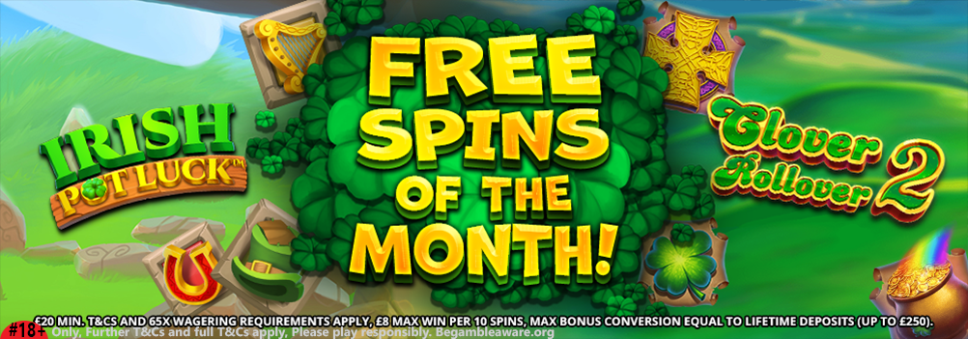
FREE SPINS OF THE MONTH
Free Spins of the Month is your chance to win 20-500 Free Spins on Irish Pot Luck or Clover Rollover 2 with every qualifying £20+ fund this month.
Additionally, the two Slot Games in this promotion will change every month, providing you with the opportunity to try out more amazing games than ever – watch this space!
We hope you enjoy our Free Spins of the month!

Slide 5

JOIN LIVE CASINO TODAY
It’s time to meet the dealer, compete against rivals, and immerse yourself in the action when you play our Live Casino Games.
Enjoy the live action of Live Casino. A casino experience like no other, from the comfort of your own home! With Live Blackjack, Live Roulette, and much more.
If you’d like to discover our live games, you can find the entire selection of Live Casino Games available by visiting the Table Games tab.

Slide 6

WELCOME OFFER
Welcome to Delicious Slots, we offer a wide range of thrilling slot games that have unique themes, excellent bonus rounds and large jackpots.
If you are looking to experience slot games that are more than fruit machines, you have come to the right place. Start gaming today with our exclusive welcome offer spin the Mega Reel for your chance to win amazing prizes including Amazon vouchers, 500 Free Spins on Starburst and Free Spins on Fluffy Favourites!
Once you have claimed your welcome offer, you’ll be able to enjoy over 500 amazing slots including Starburst, Fluffy Favourites, Rainbow Riches, Chilli Heat and Gonzo’s Quest.
Delicious Slots is sure to please!

Slide 7

Fun-loaded Free Slot Machines with Free Spins
Delicious games lives up to it’s promises and words by offering what it claims. The site has a real range of new slots online including brand new video slots and jackpot slots. Those who love to play free slot machines can easily indulge in free slot entertainment at Happy Hours promotion. There are multiple free slots offered by the site where players don’t need to pay anything extra. And those who want to win jackpots or hefty pay-outs, they can find out a good selection of jackpot slots. Every jackpot slot offered by the site carries a lot of fun and high quality of entertainment value. For an instance, the site offers Fluffy Favourites, starburst slot in UK and many more that other casino sites don’t offer.

Slide 8
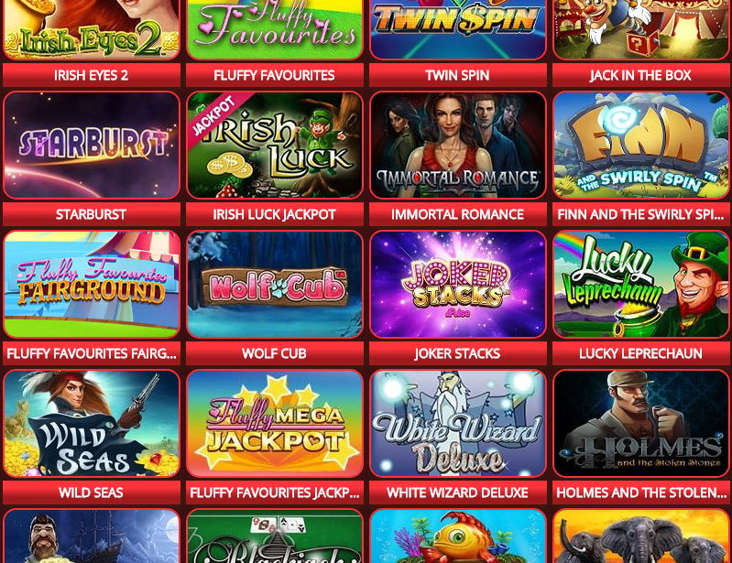


One of the best mega reel sites in the UK
The site is also known for it’s mega reel feature where players will get incredible amount of free spins by spinning the mega reel. Right at the time of signup process, the site gives you an opportunity to spin the mega reel and win up to 500 free spins on Starburst slot machine or Fluffy Favourites.

Slide 9
#18+ Only, Further T&Cs and full T&Cs apply, Please play responsibly. Begambleaware.org
DISCLAIMER – All promotional codes or free bet offers, welcome bonuses and promotions that are listed on this site are subject to the terms and conditions of the respective operators. COOKIES – bestonlinebingogame.wordpress.com uses first and third party cookies on your computer to enhance this site and provide functionality. By continuing to use our site we will assume

