Slide 1
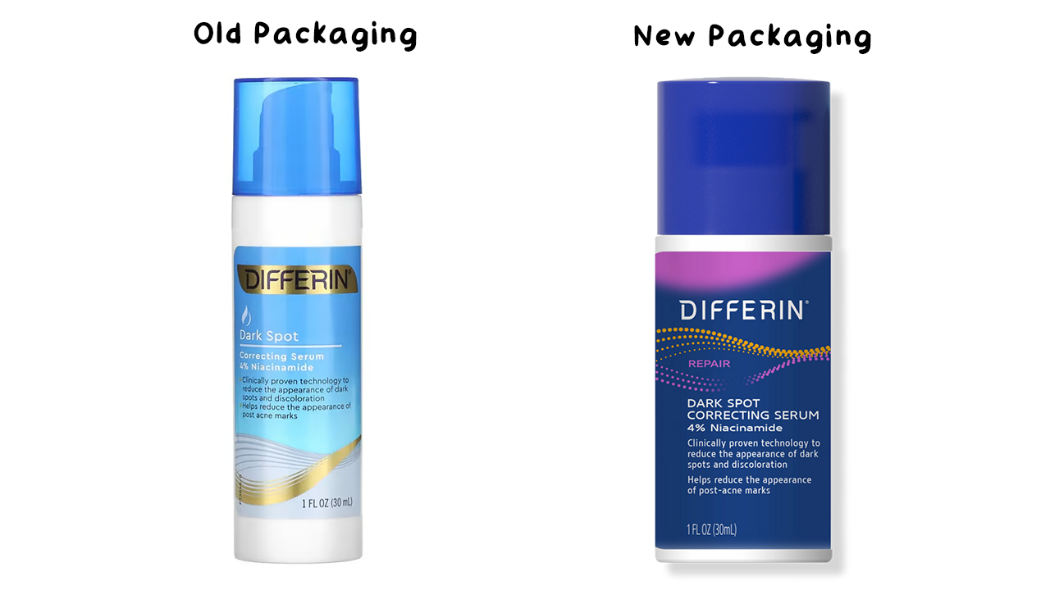

Slide 2
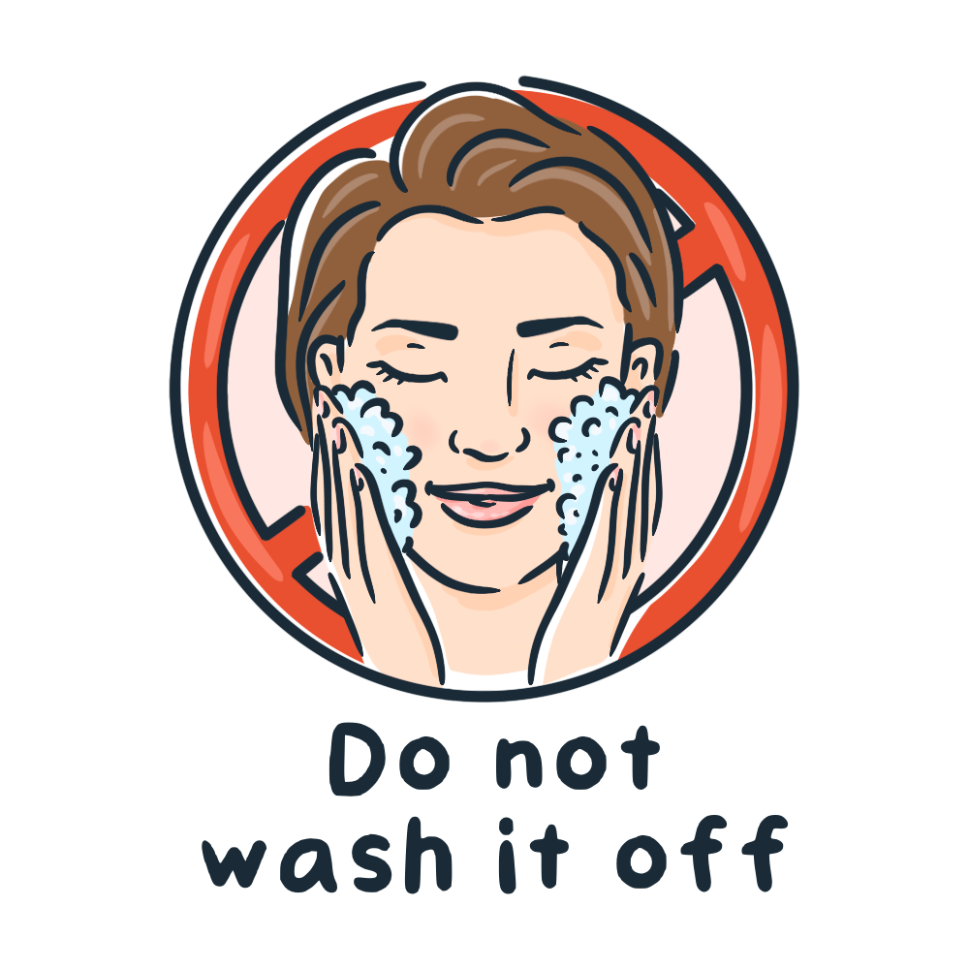
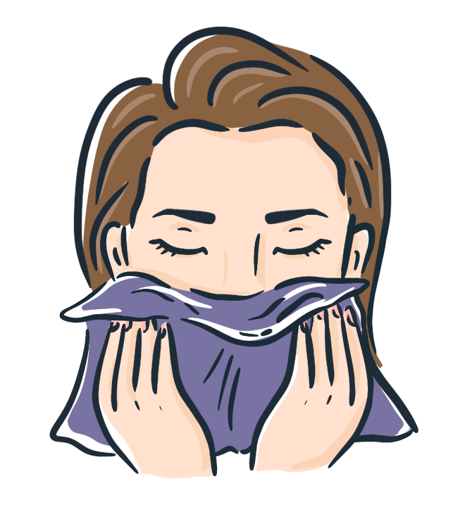


Morning Skincare Routine: Cleanse, Hydrate, Reduce Enlarged Pores, Fade Dark Spots, and Protect Against UV Damage.
Step 1. Cleanser (Water-Based) |  | Step 2. Hydrating Toner (Optional) |  | Step 3. Face Serum |  | Step 4. Moisturizer (Optional) |  | Step 5. Sunscreen
Examples:
Differin Pore-Minimizing Toner or Isntree Green Tea Fresh Toner
Examples:
Winona Sunblock Milk Sunscreen SPF48 PA+++ (All Skin Types – Chemical + Mineral) or Good Molecules Sheer Mineral SPF 30 (All Skin Types – Slight White cast)
Examples:
Cetaphil Daily Facial Cleanser (Normal to Oily Skin) or Beauty of Joseon Green Plum Refreshing Cleanser (All Skin Types)
Differin Dark Spot Correcting Serum (4% Niacinamide)
Examples:
CeraVe Ultra-Light Moisturizing Gel (Normal to Oily Skin) or The Ordinary Natural NMF+Beta Glucan (Normal to Oily Skin)
Water-Based Cleansers: First, wet your face. Then, dispense about a coin-sized amount of cleanser into the palm of your hand or onto your fingers. Rub your hands together and gently massage the cleanser onto your face for about 15-30 seconds, ensuring all areas are covered. Optionally, you can use a soft, clean, damp microfiber washcloth to help remove the cleanser. Afterwards, rinse thoroughly and pat dry using a clean towel. Hydrating Toner: To apply the toner, first dampen a cotton pad with the product, ensuring not to over-soak the pad. Gently swipe the pad across your face and neck. Alternatively, you can dispense about a coin-sized amount of toner into the palm of your hand, rub your hands together, and then apply it evenly over your face and neck. Do not rinse. Dark Spot Serum: Dispense about a pea-sized amount of the serum onto your fingertips. Rub the fingertips of both hands together, then gently massage it over the entire face, extending to the neck if desired. Do not rinse.
Moisturizer: Dispense about a pea-to-bean-sized amount of moisturizer onto your fingertips. Rub the fingertips of both hands together, then massage it all over your face and neck or only onto desired areas. Do not rinse. Sunscreen: I recommend using sunscreen whenever you spend prolonged periods outdoors. For optimal protection, you need to use a fair amount. Apply about one-third to half a teaspoon to your face, neck, and a bit of your décolletage, ensuring all exposed skin is covered. Allow the sunscreen to fully absorb and set by applying it 10-15 minutes before going outside. Sunscreen Reminder: Remember to reapply sunscreen every two hours when spending extended periods outdoors. Reapply immediately if the sunscreen has rubbed off, or in case of heavy sweating, swimming, or engaging in prolonged outdoor activities. However, if you spend most of your time indoors, frequent reapplication of sunscreen isn't necessary unless you are near windows receiving significant sunlight for extended periods. Eyelids/Eye Area: The skin around the eyes is thin and delicate. Avoid using skincare products with active ingredients on the eyelids unless specified. Important Note: Please remember that this guide reflects my personal experience with these products. Skincare is highly individual, and responses to products can vary. Therefore, the amounts suggested here are a starting point. You may find that you need slightly more or less of each product. Adjust the quantities to suit your specific skin needs and responses.

Slide 3
Evening Skincare Routine: Cleanse, Hydrate, Reduce Enlarged Pores, Fade Dark Spots, and Protect with a Lightweight Moisture Seal.
Examples:
Differin Pore-Minimizing Toner or Isntree Green Tea Fresh Toner
Examples:
CeraVe Ultra-Light Moisturizing Gel (Normal to Oily Skin) or The Ordinary NMF + Beta Glucan (Normal to Oily Skin)
Examples:
Beauty of Joseon Radiance Cleansing Balm (All Skin Types) and/or Cetaphil Daily Facial Cleanser (Normal to Oily Skin) or Beauty of Joseon Green Plum Refreshing Cleanser (All Skin Types)
Differin Dark Spot Correcting Serum (4% Niacinamide)
Step 1. Cleansing Balm and/or Water-Based Cleanser |  | Step 2. Hydrating Toner (Optional) |  | Step 3. Face Serum |  | Step 4. Moisturizer
Cleansing Balm: The cleansing balm helps effectively dissolve and lift makeup and sunscreen from the skin's surface, while being gentle. To use, begin by dispensing a coin-sized amount of the balm into the palm of your hand. Rub your hands together for 15-30 seconds to warm the product. Then, apply it to your dry, bare face, or directly over sunscreen or makeup. Gently massage it into your face and neck, including around your eyes, for about 1 minute, ensuring every area is covered. Optionally, you can use a soft, clean, damp microfiber washcloth to assist in removing the cleanser, sunscreen, and/or makeup. Finally, rinse thoroughly and follow with the gel to foam cleanser. Water-Based Cleansers: First, wet your face. Then, dispense about a coin-sized amount of cleanser into the palm of your hand or onto your fingers. Rub your hands together and gently massage the cleanser onto your face for about 15-30 seconds, ensuring all areas are covered. Optionally, you can use a soft, clean, damp microfiber washcloth to help remove the cleanser. Afterwards, rinse thoroughly and pat dry using a clean towel. Toner: To apply the toner, first dampen a cotton pad with the product, ensuring not to over-soak the pad. Gently swipe the pad across your face and neck. Alternatively, you can dispense about a coin-sized amount of toner into the palm of your hand, rub your hands together, and then apply it evenly over your face and neck. Do not rinse. Dark Spot Serum: Dispense about a pea-sized amount of the serum onto your fingertips. Rub the fingertips of both hands together, then gently massage it over the entire face, extending to the neck if desired. Do not rinse.
Moisturizer: Dispense about a pea-to-bean-sized amount of moisturizer onto your fingertips. Rub the fingertips of both hands together, then massage it all over your face and neck or only onto desired areas. Do not rinse.
Eyelids/Eye Area: The skin around the eyes is thin and delicate. Avoid using skincare products with active ingredients on the eyelids unless specified. Important Note: Please remember that this guide reflects my personal experience with these products. Skincare is highly individual, and responses to products can vary. Therefore, the amounts suggested here are a starting point. You may find that you need slightly more or less of each product. Adjust the quantities to suit your specific skin needs and responses.

Slide 4
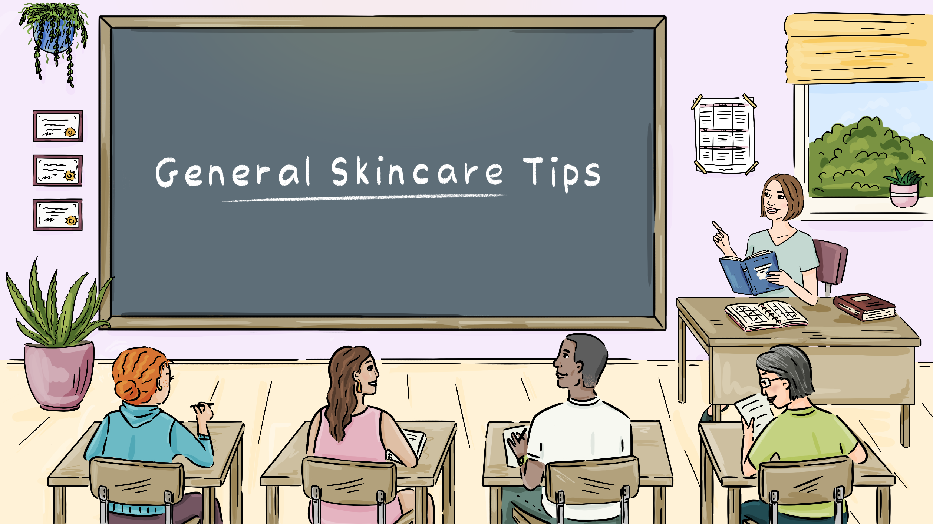

Slide 5
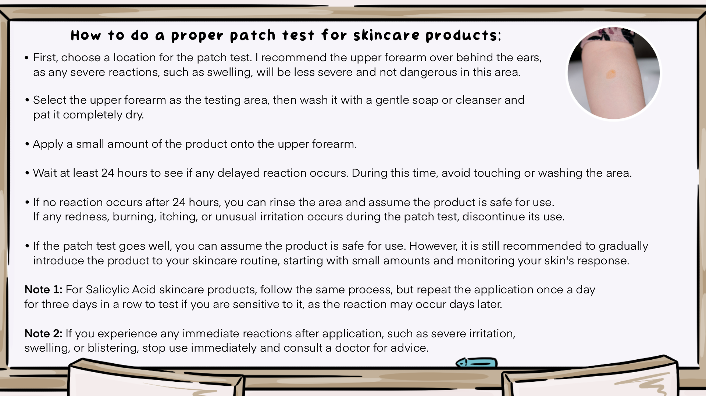

Slide 6
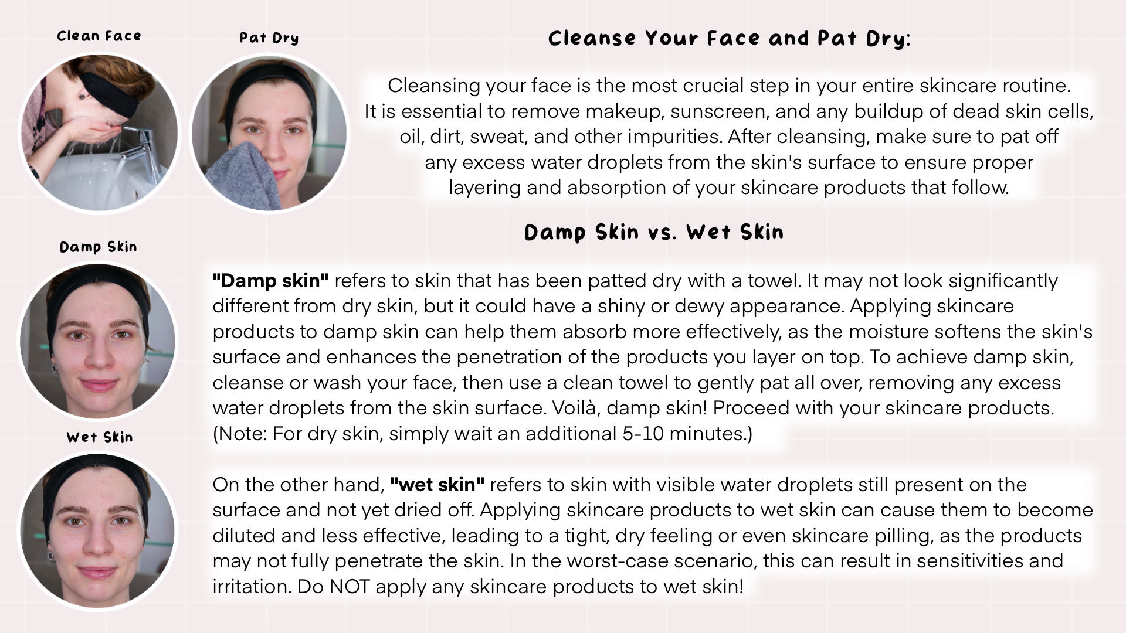

Slide 7
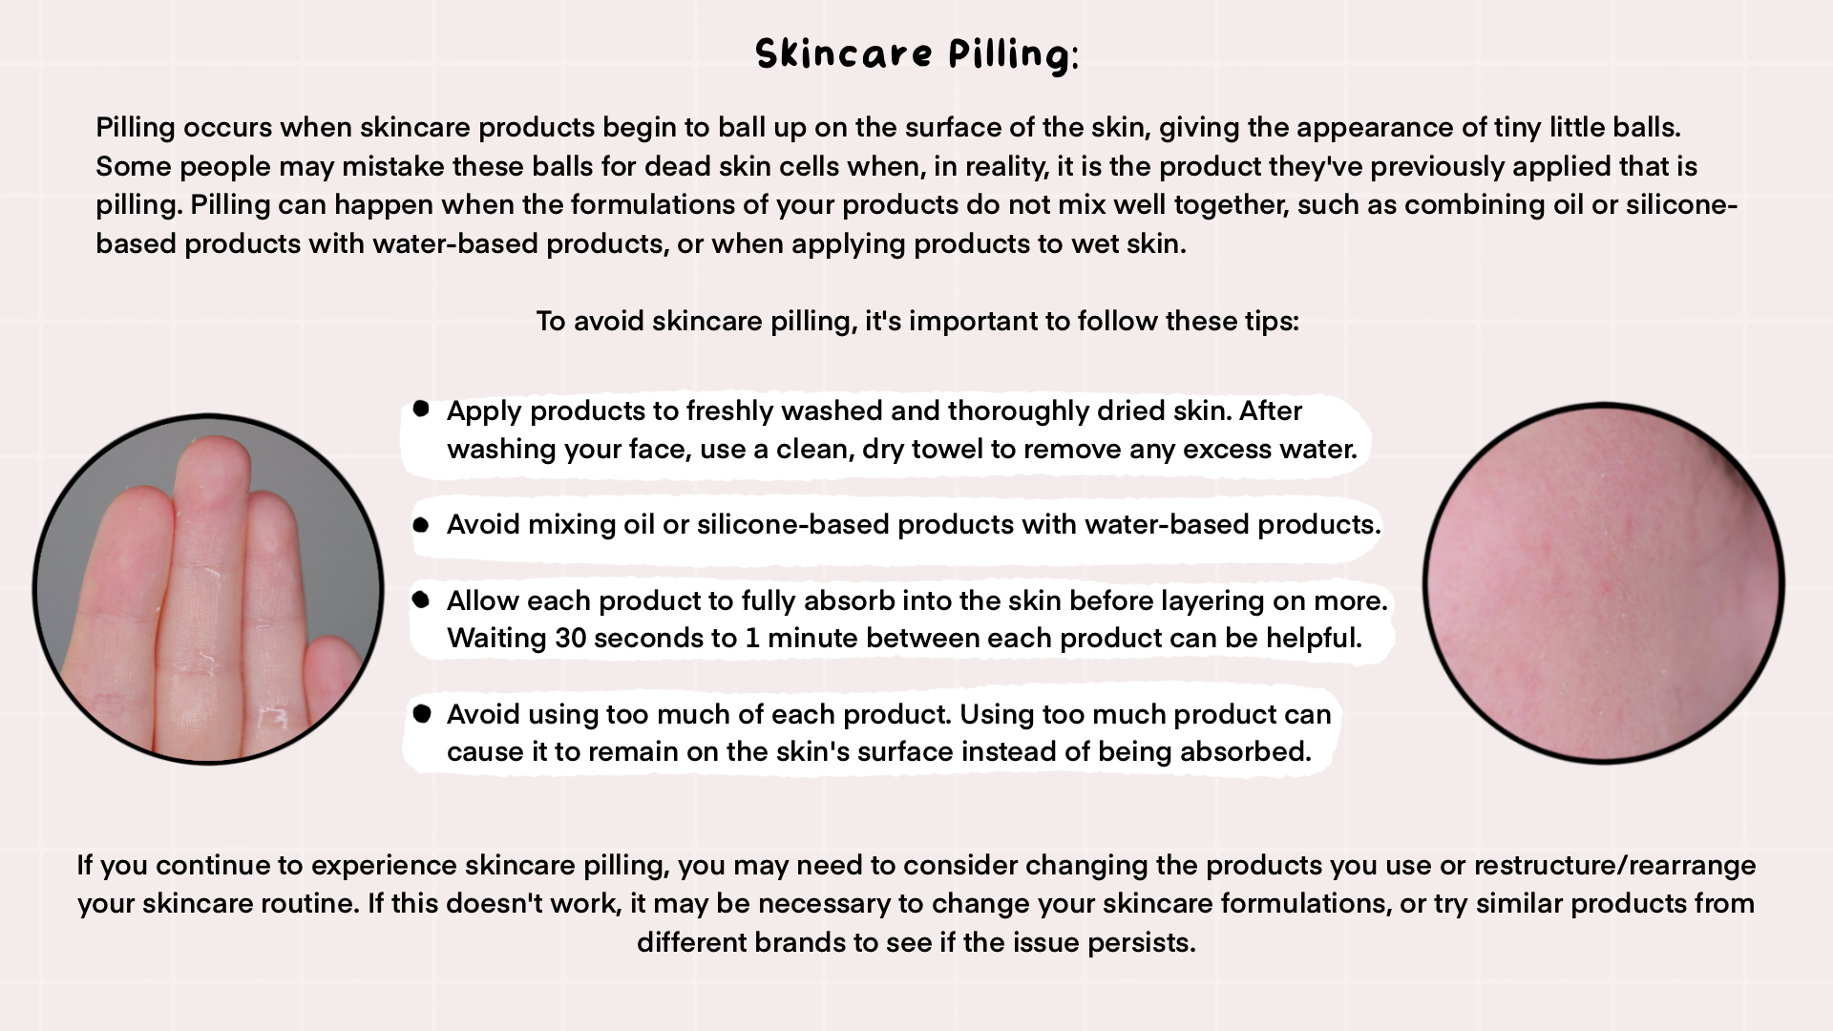

Slide 8


Slide 9
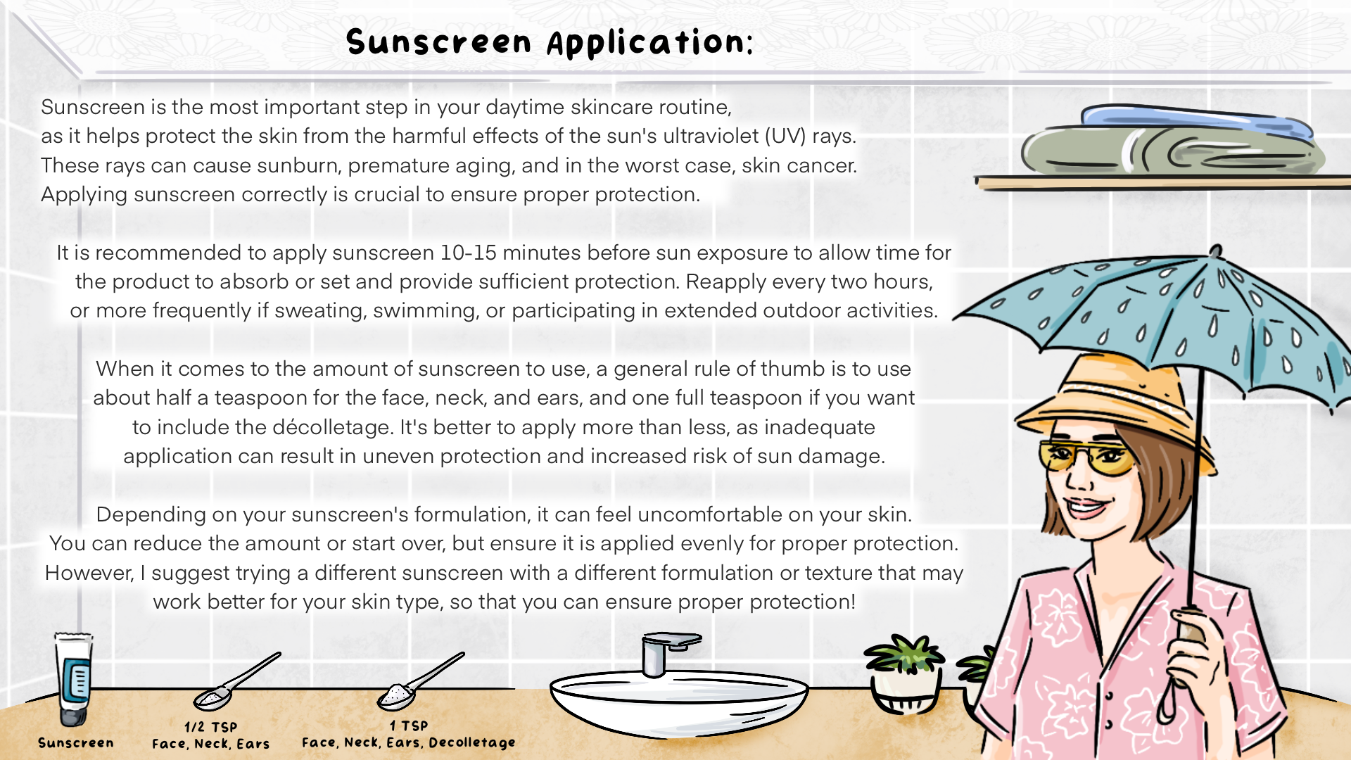

Slide 10
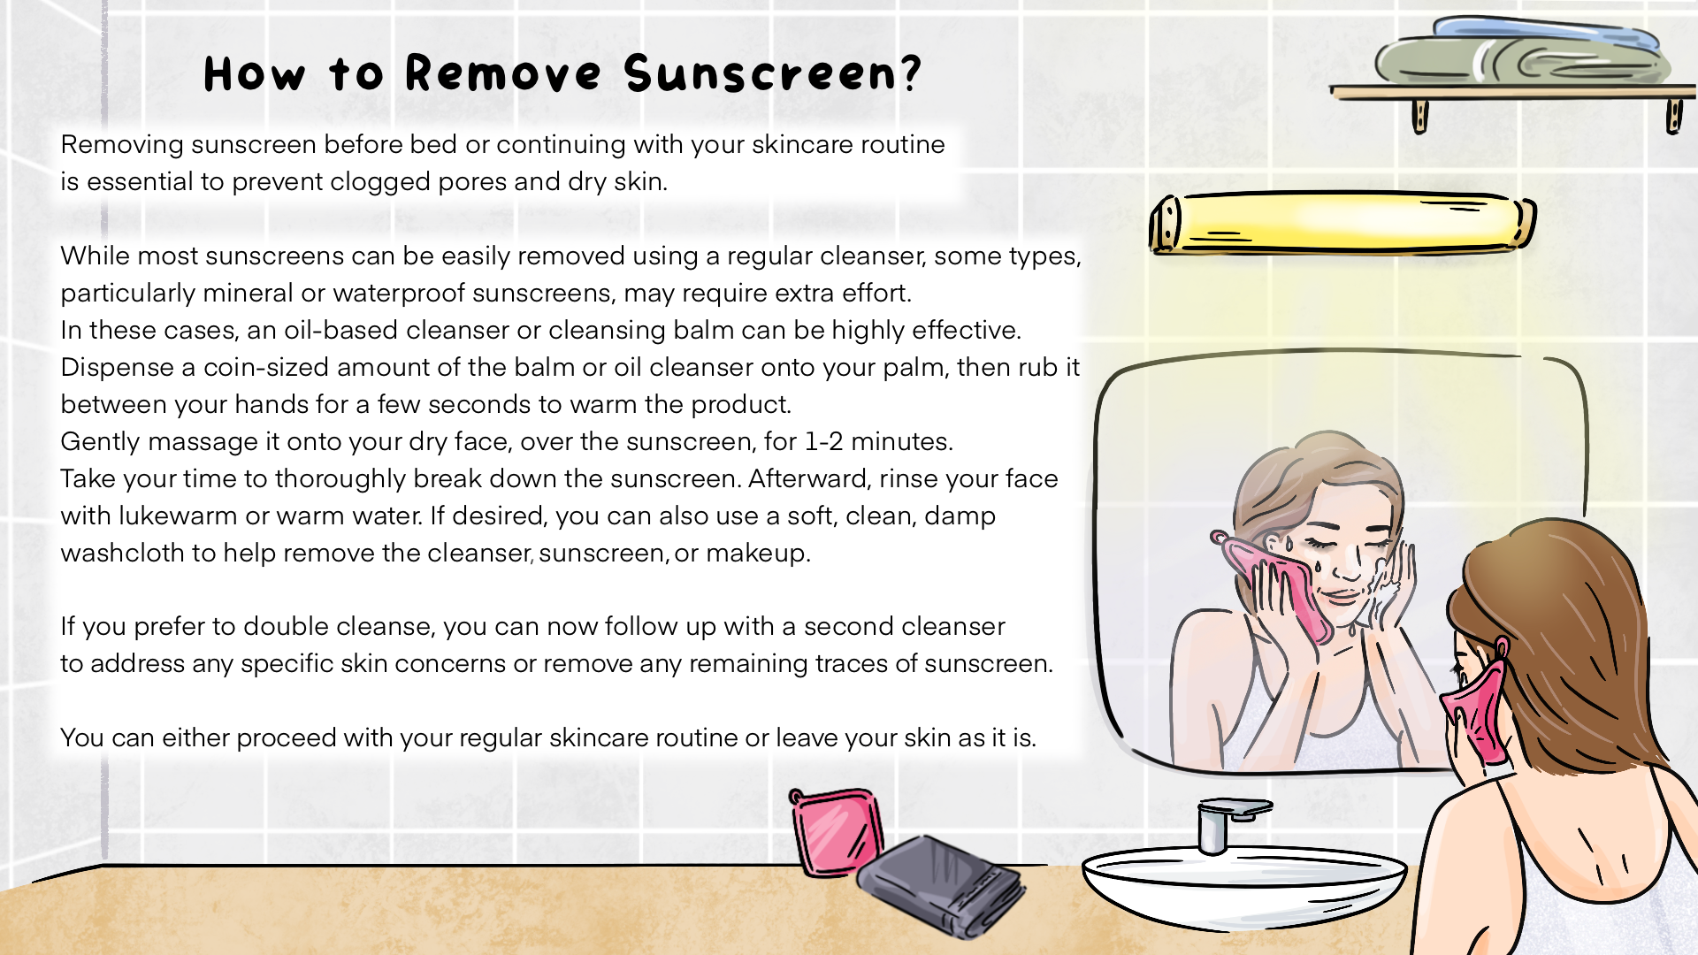

Slide 11
