Slide 1
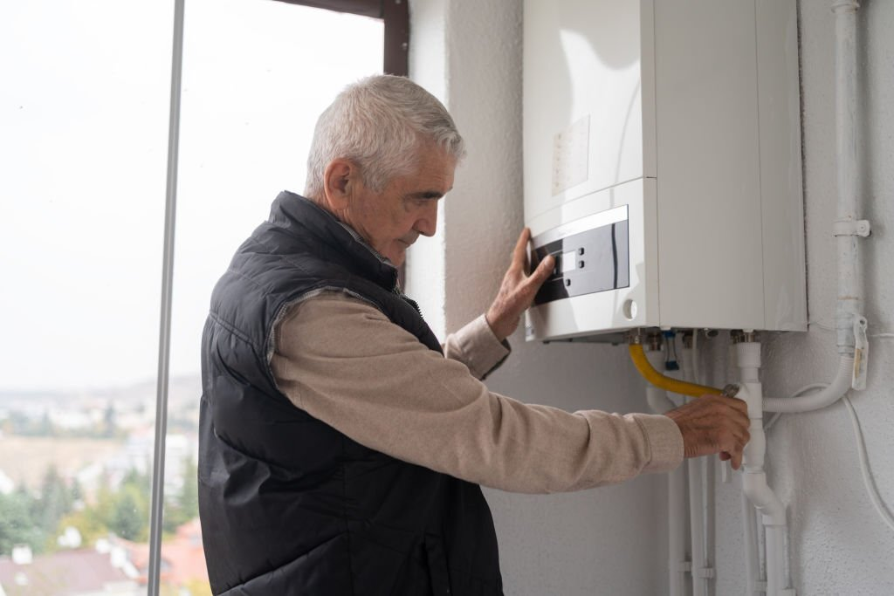
Certified Services of Boiler Repair and Servicing in Coquitlam

Slide 2
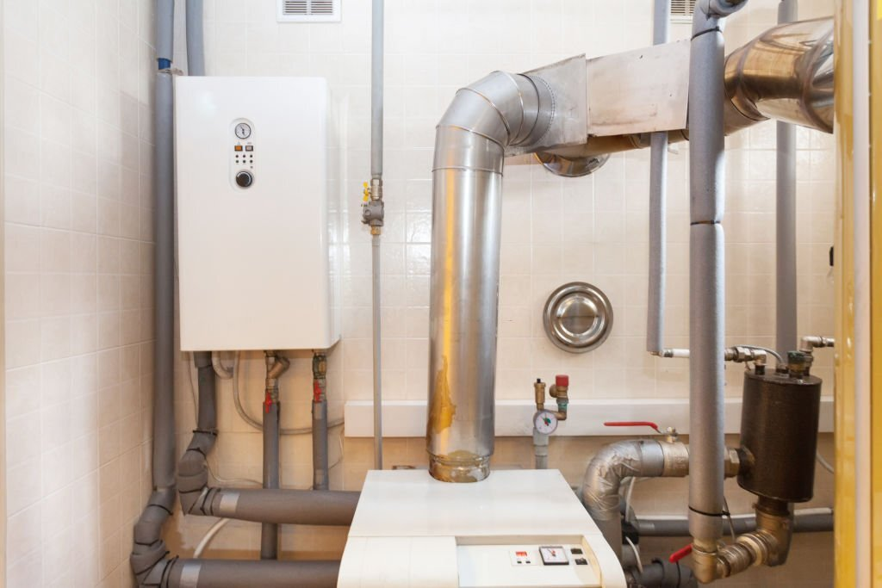
If your water heater breaks down, you should hire a business with experience making these sorts of fixes. If your water heater needs repair or maintenance, you should have a qualified technician take a look at it. Professionals should handle any repairs or replacements to hot water tanks.

Slide 3
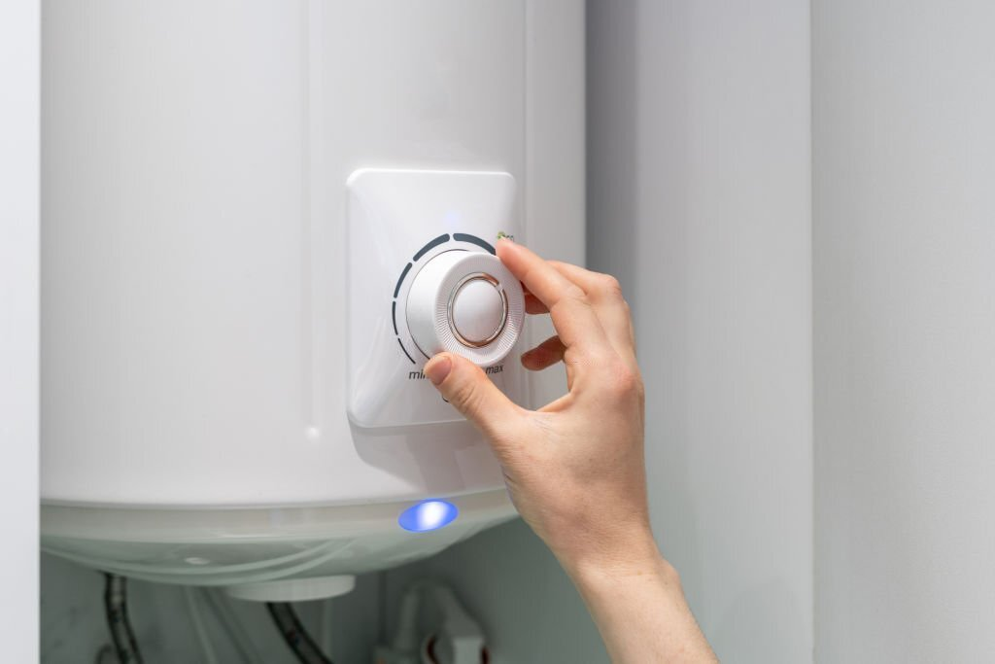
The experts will work efficiently to restore your hot water tank because they know how crucial it is. Professionals have the expertise to repair or replace your water heater, whether it is gas or electric. Due to this, it is essential for residents to have access to hot water tanks repair and servicing in Port Coquitlam.

Slide 4
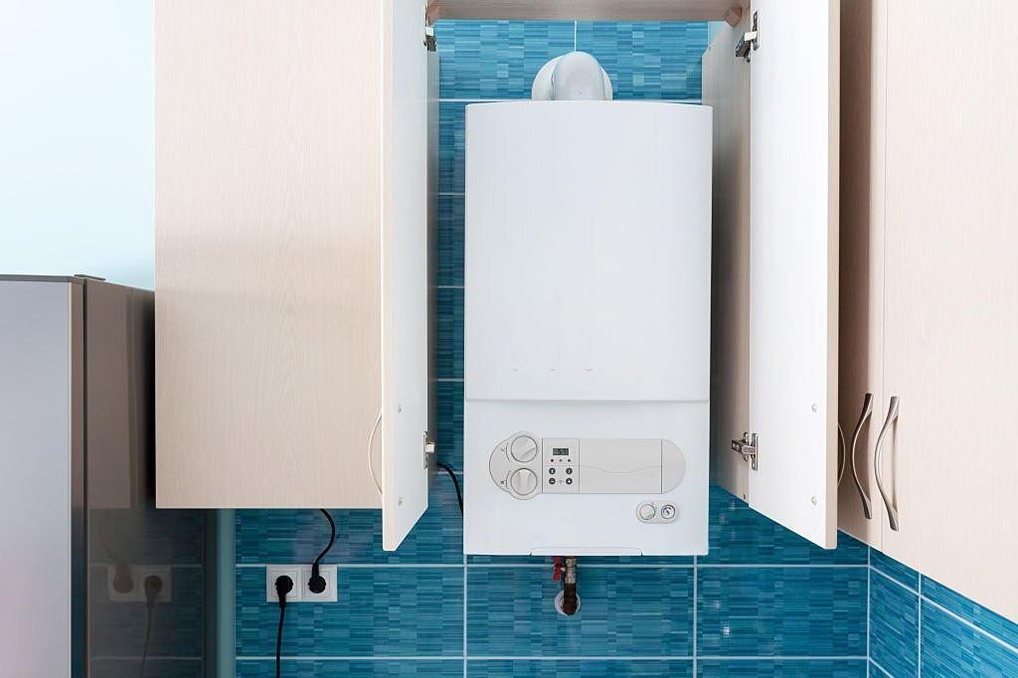
Homeowners would do well to familiarize themselves with the ins and outs of hot water tank setup, maintenance, and repair. If you want to heat water, you can choose from a variety of heating elements for your hot water tank, each one tailored to the specifics of your model and brand.

Slide 5
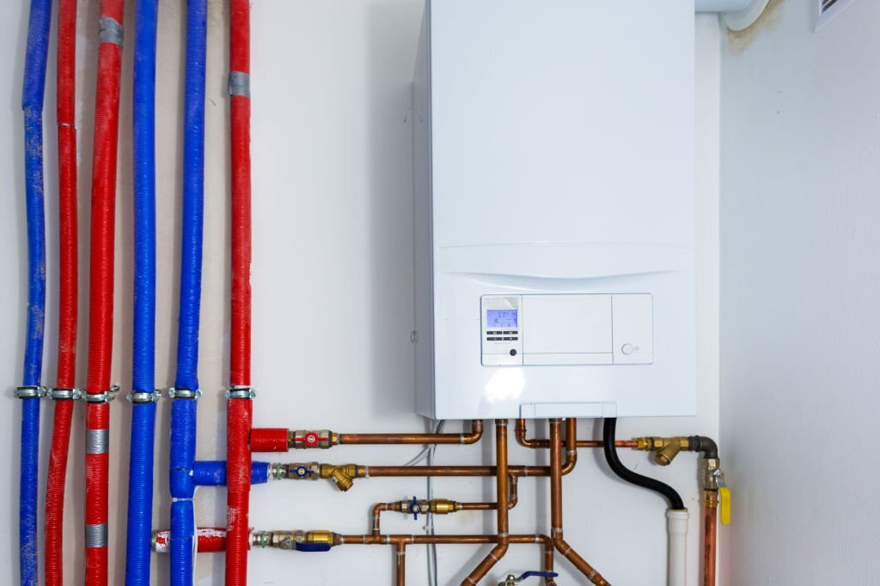
The water tank on some types may be removed and the heating element replaced quickly, while on others it is necessary to replace the complete unit. If you want your hot water tank to last as long as possible and perform at peak efficiency, you should have it serviced regularly.

Slide 6
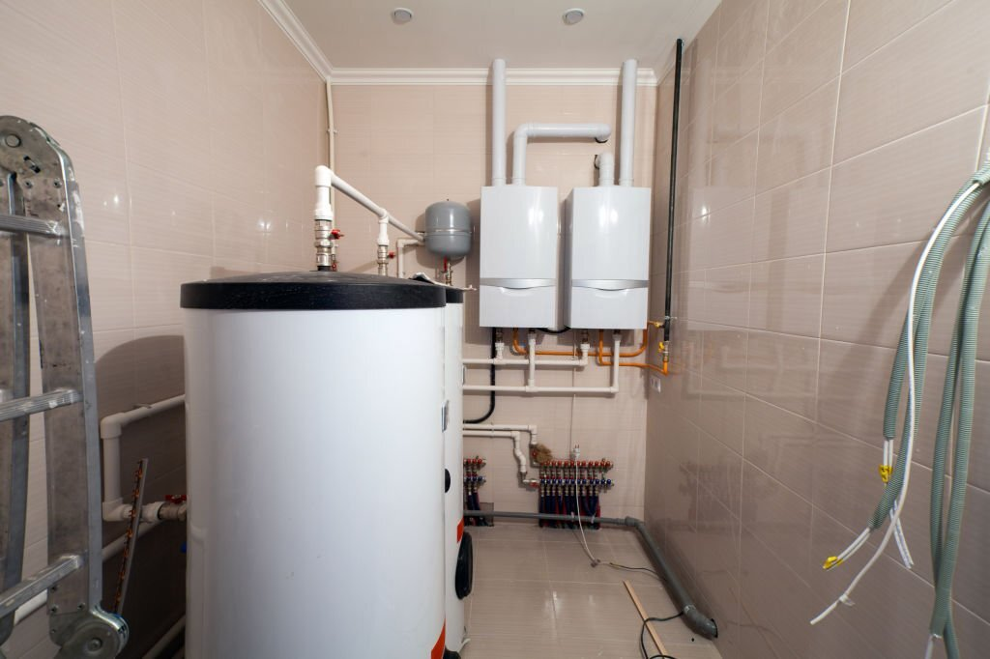
The topic of hot water tanks repair and servicing in Maple Ridge is crucial. Homeowners can avoid expensive repairs by using this method. It is recommended that you have your boiler repair and servicing in Coquitlam to extend its life. Water is heated via pressure in a vessel called a boiler, and the heat comes from an internal combustion engine.

Slide 7
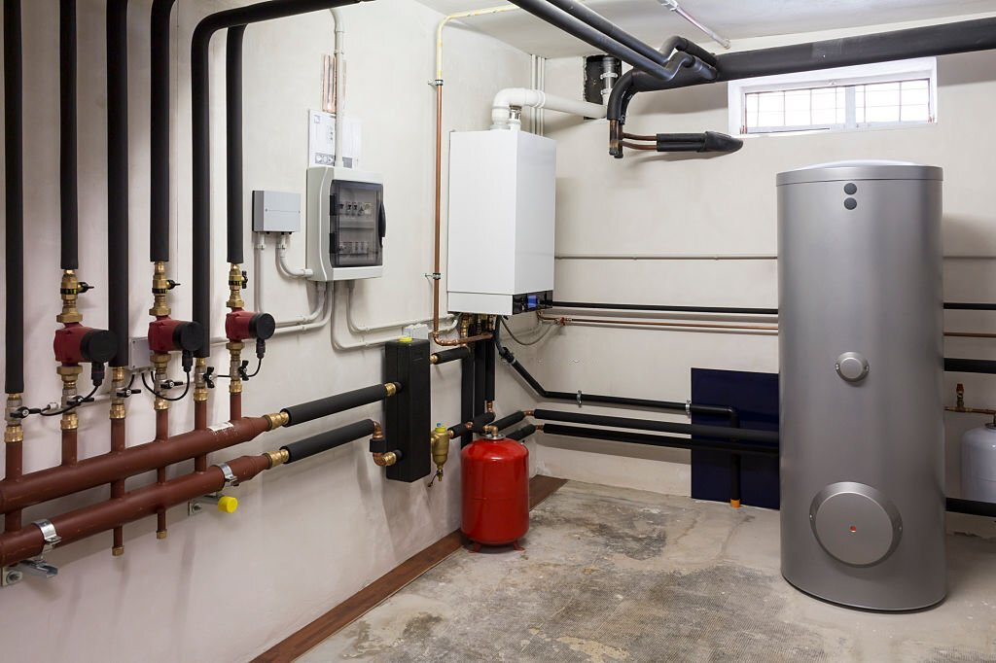
If you want your boiler to last and perform well, regular maintenance inspections are a must. Cleaning it on a regular basis will help keep soot and dirt from accumulating and blocking the system. It's also important to perform routine maintenance, such as topping off the water supply and ensuring proper pressure. A properly serviced boiler guarantees the equipment's security, usefulness, and longevity.

Slide 8
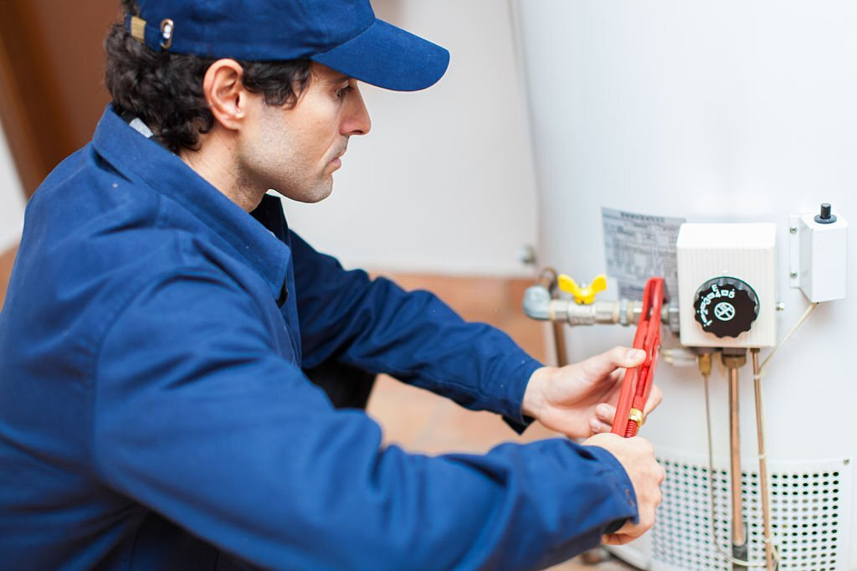
Having a professional boiler repair and servicing in Maple Ridge. Will fix and service your boiler can give you a boiler that works well. If a homeowner notices something wrong with their boiler, they should call a professional boiler repair company right away.

Slide 9
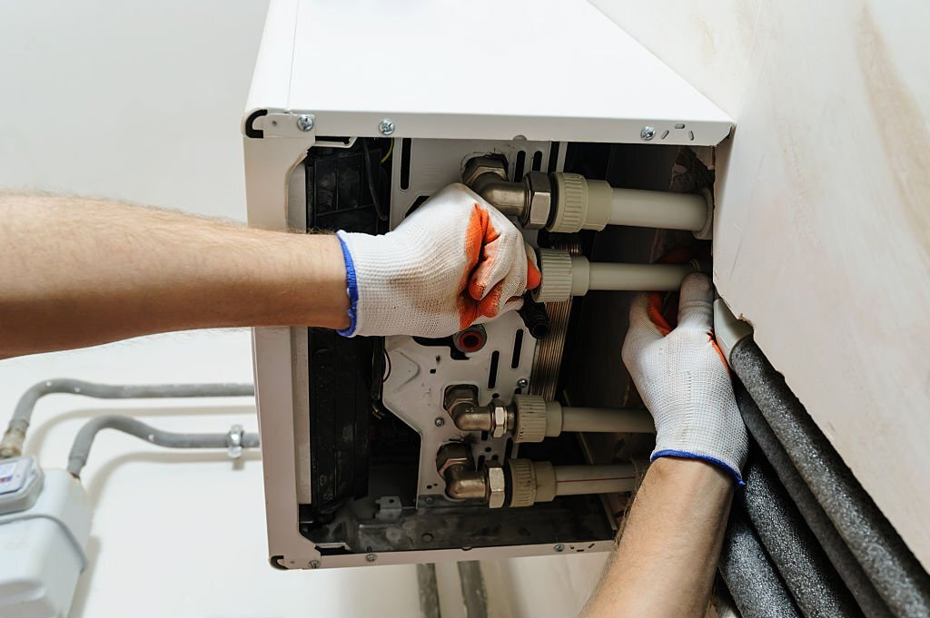
A good company that fixes and maintains boilers will be able to fix the problem quickly and effectively so the customer can get back to their normal routine. Boiler repair and servicing in Langley is hard and takes a lot of time. Professionals offer full boiler maintenance and repair services, from the first diagnosis to a full replacement.

Slide 10
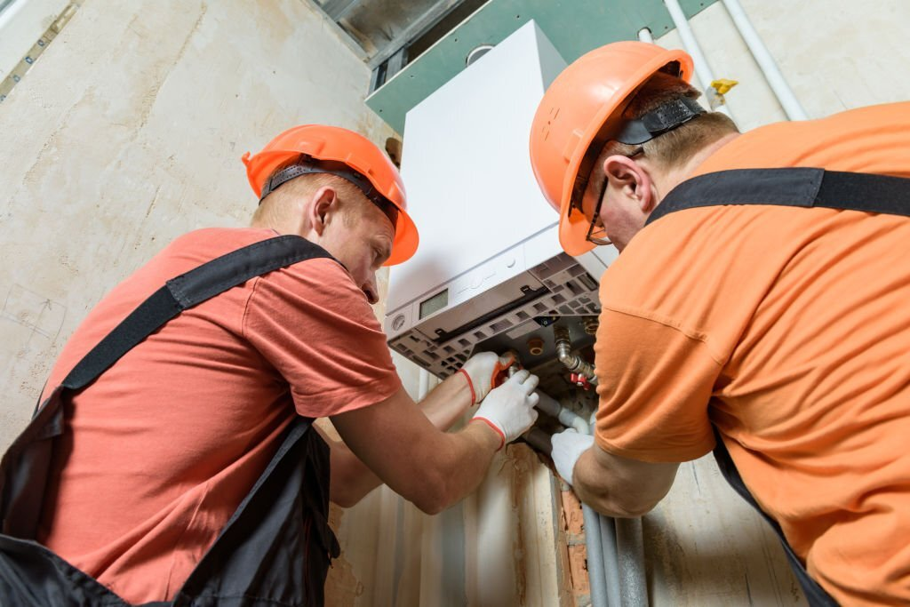
Expert technicians know that a broken boiler can be very annoying, so they work quickly and efficiently to get your boiler back to normal as soon as possible. You can undertake part of the maintenance on your hot water tank, such as inspecting and draining it, but you should always have a professional take care of any major repairs or service.

Slide 11
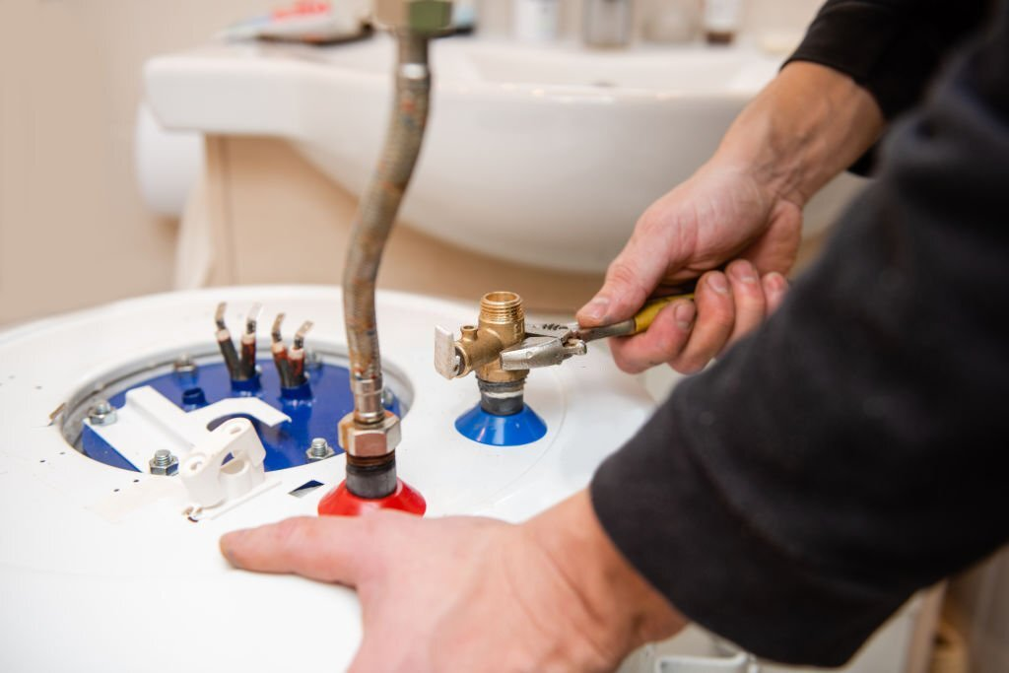
Certified engineers at All West Heating & Cooling LTD are available at any time to answer your questions, address your concerns, and help you make the most informed choice possible.

Slide 12


